Slide 1
Hydrological analysis of historical floods
LECTURE CONTENT:
1) Data availability and reliability
2) Applications of long-term data series in science and water management
Tomáš Vlasák
Czech Hydrometeorological Institute
Forecasting office České Budějovice

Slide 2
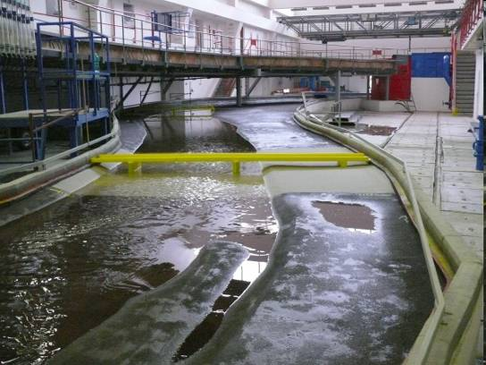
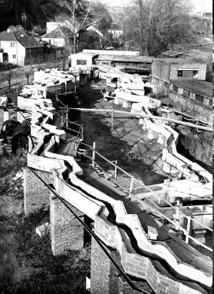
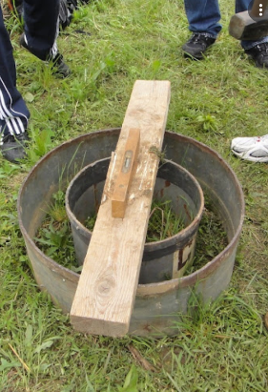
Quantitative hydrology is depended on observation in the landscape (in situ) more then other natural sciences.
EXEPTIONS: “Hydrological laboratories”
River channel model in T. G. Masaryk Water Research Institute
Infiltrometer

Slide 3
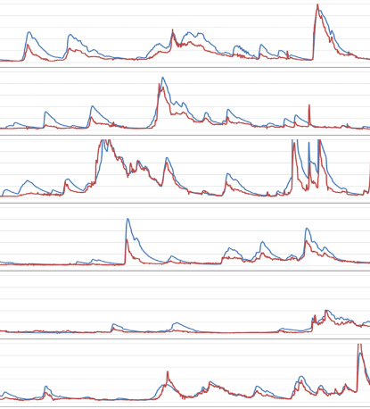
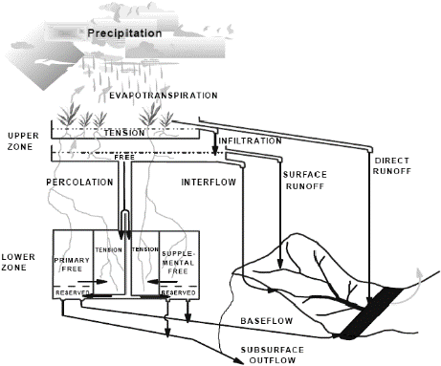
Quantitative hydrology is depended on observation in the landscape (in situ) more then other natural sciences.
Hydrological models could be partial substitution of observation.
Disadvantages: 1) Observed values (model inputs) are required.
2) Flow values are needed for model calibration.
3) Bigger uncertainty in modelling of extremes.

Slide 4
Availability of data for quantitative hydrology are often the main limitation for hydrological research and application
We only have data available from a small number of locations.
Data accuracy and reliability is affected by measurement methods and other conditions.
Time series are limited to the length of the observation.

Slide 5
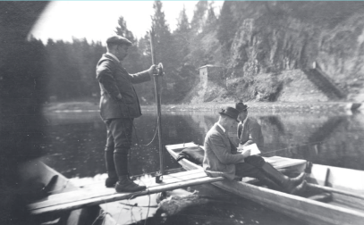
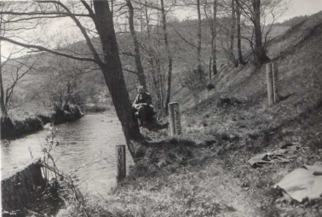
Hydrological data from instrumental period in the CZ
The length of the hydrological and meteorological observations in the Czech republic is very long. However, the measurement technique and data quality had its own development
What you need to know about long-time data series:
Length of and continuity of observation
Reliability and Errors
Homogeneity

Slide 6
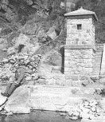
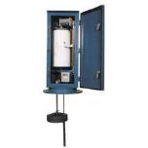
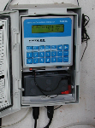
River stage and discharge observation
Length of available data in the area of Czech republic
2000
1900
1800
1998 automated gauges
1875 – daily systematic observation at many sites in the CR
1994 digitization of all river gauge record papers
20‘s of 20th century–mechanical record device
1825 – daily observation of Vltava river stage in Prague
(Daily mean discharge, peak flows and selected flood waves are digitized since the beginning of observation)

Slide 7
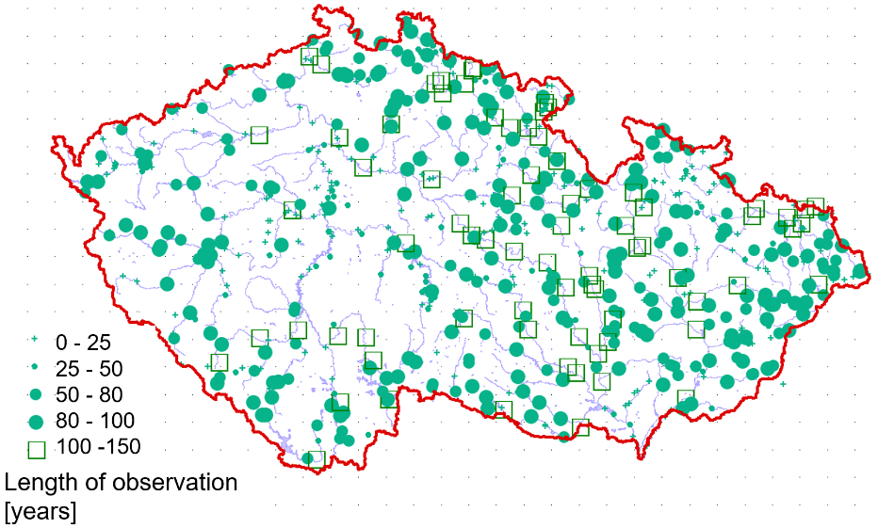
River stage and discharge observation
Length of available data
There are ~500 water-gauging stations operated by ČHMÚ. Measured water stages are transformed to discharge in all of them.

Slide 8
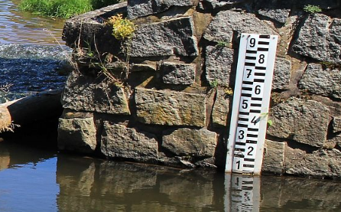
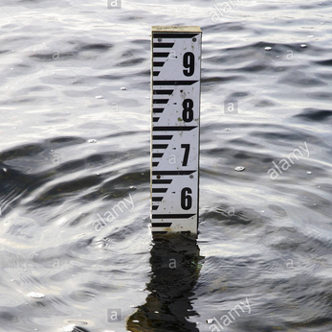
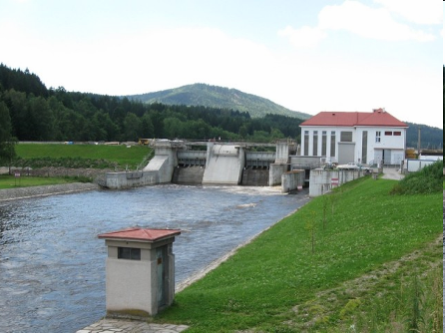
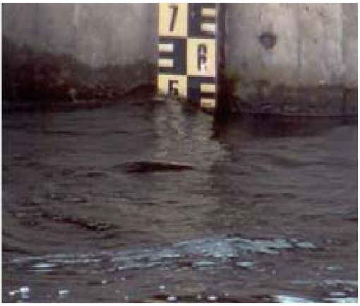
River stage and discharge observation
Measurement Errors
The water level is measured directly.
The measurement reliability is high for the whole period of observation.

Slide 9
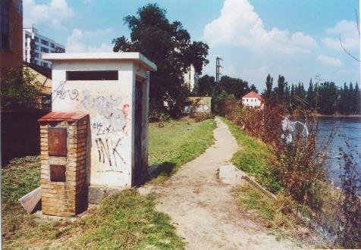
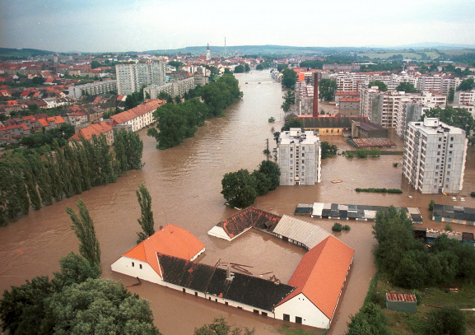
River stage and discharge observation
Measurement Errors
Some water gauging stations were destroyed during extreme flooding in 2002 (more then 100 year flood).
Water stage
records had to
be reconstructed.
Peak river stage
Location of gauging station Písek

Slide 10
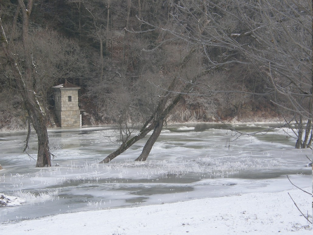
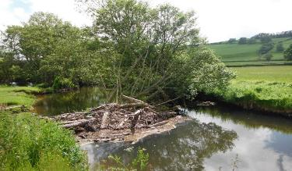
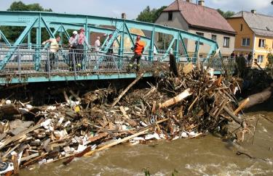
River stage and discharge observation
Measurement Errors
River stage may be affected by other influences than flow.

Slide 11
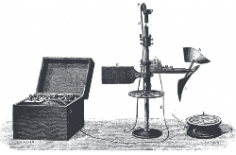
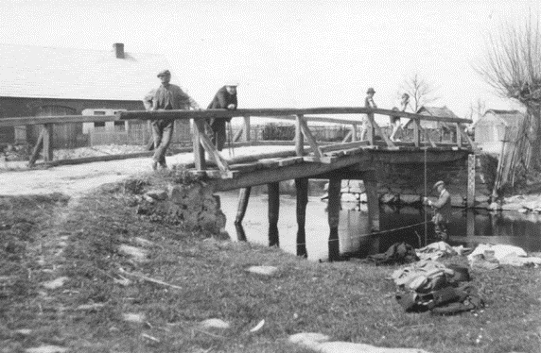
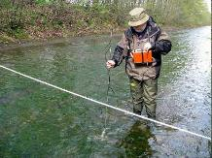
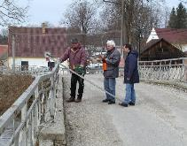
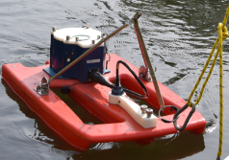
River stage and discharge observation
Discharge direct measurement
Frequency of measurement
Development of measuring techniques
1900
1950
2000

Slide 12
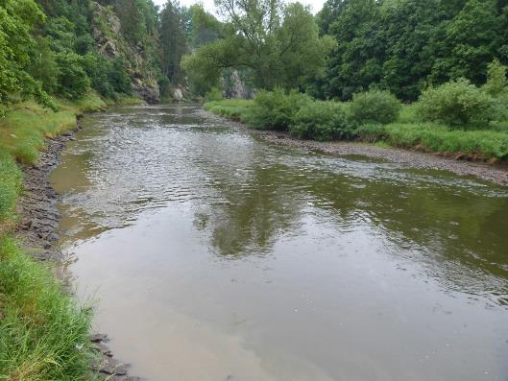
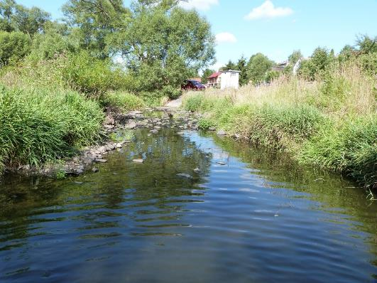
River stage and discharge observation
A stable riverbed means much more certainty in the flow estimate
Rating curves of Bechyně water gauging station with rock bed channel
Rating curves of Ostrovec water gauging station with gravel bed channel

Slide 13
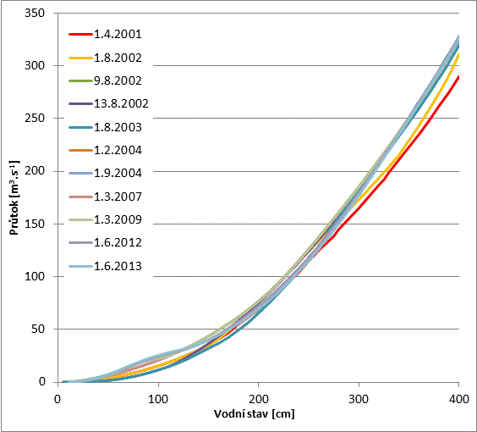
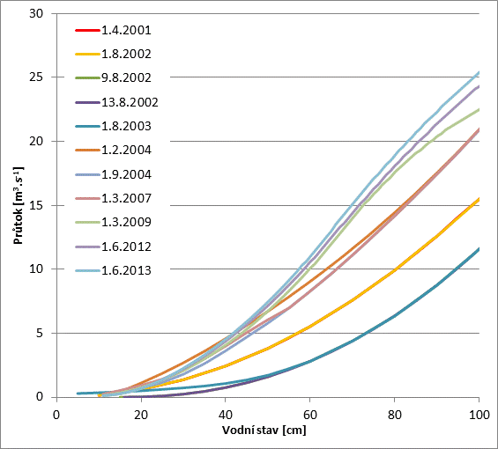
River stage and discharge observation
A stable riverbed means much more certainty in the flow estimate
Rating curves of Bechyně water gauging station with rock bed channel
Rating curves of Ostrovec water gauging station with gravel bed channel

Slide 14
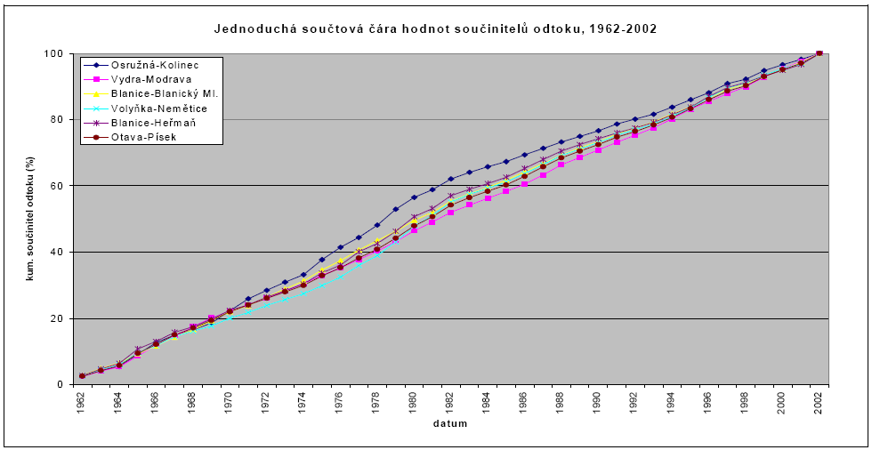
River stage and discharge observation
If you are not aware of possible measurement errors, you may make a wrong conclusion
Scientist approach: Blue sum line indicates a change in the rainfall-runoff relationship, probably due to a change in land-use
Hydrologist - technician: The rating curve was updated only once in too long period. It is highly probable, that observed flow was biased.

Slide 15
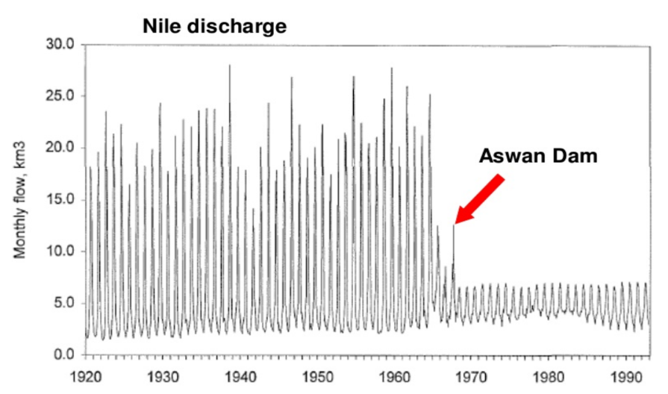
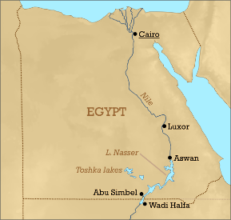
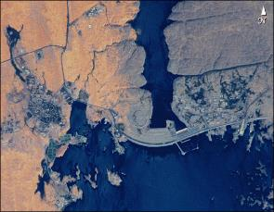
River stage and discharge observation
Homogeneity of data – influence of water management structures

Slide 16
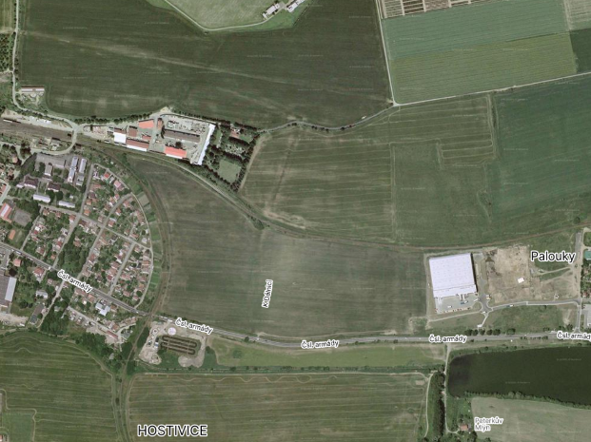
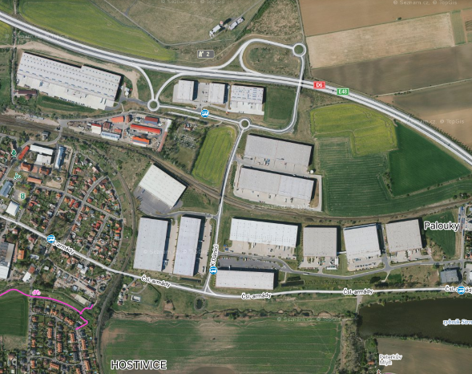
River stage and discharge observation
Homogeneity of data – influence of land-use changes

Slide 17
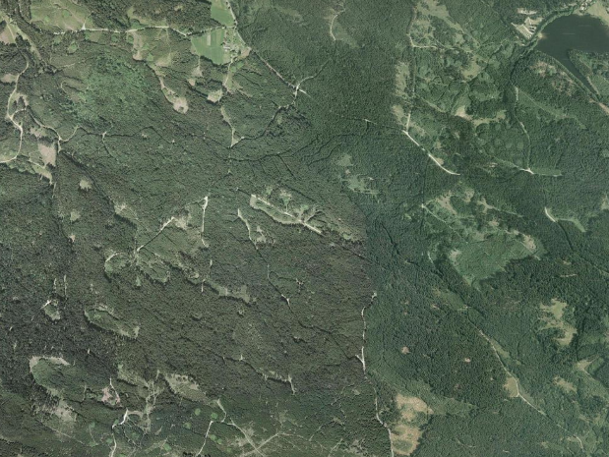
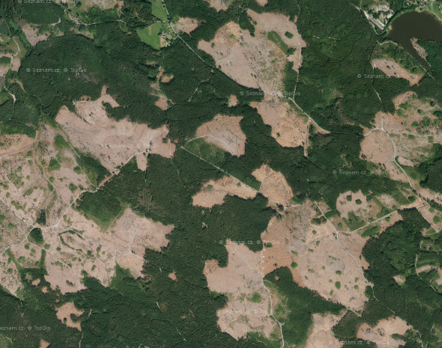
River stage and discharge observation
Homogeneity of data – influence of land-use changes

Slide 18
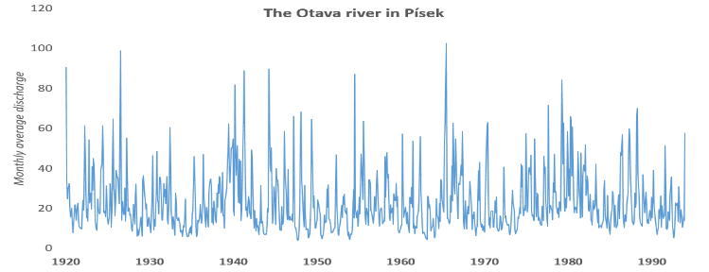
Discussion
?
Why is there a more apparent pattern in the Nile's average monthly flows than in the Otava river ?
www.wxcharts.com

Slide 19
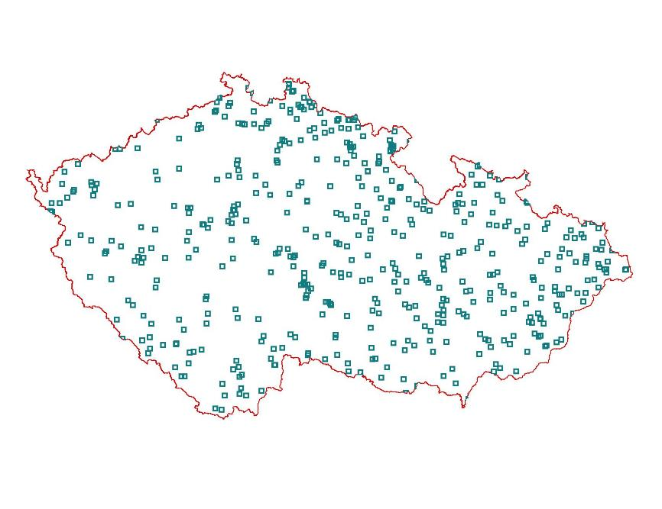
River stage and discharge observation
ČHMÚ operates more than 500 water gauging stations

Slide 20
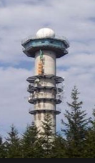
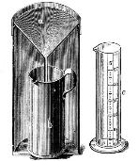
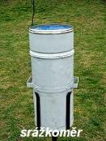
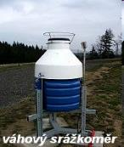
Rainfall and air temperature observation
Length of observation
2000
1900
1800
Automated rain gauge
80‘s of 19th century sufficient number of stations for spatial analysis
Meteorological radar
1961 – digitization of all meteorological records.
1752 – start of daily rainfall totals observation in Klementinum

Slide 21
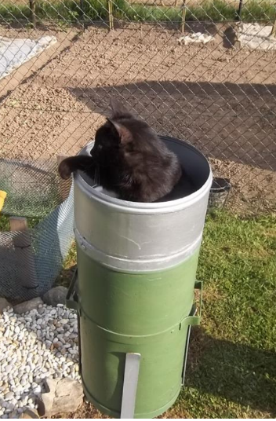
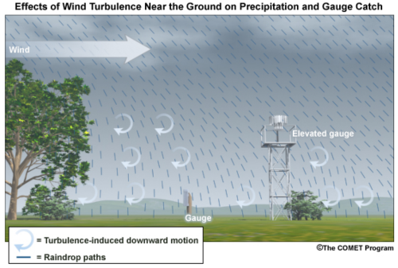
Rainfall and air temperature observation
Measurement Errors of Rainfall Observation – Manual Raingauge
Random errors
the observer's failure
Systematic errors
Position and Wind

Slide 22
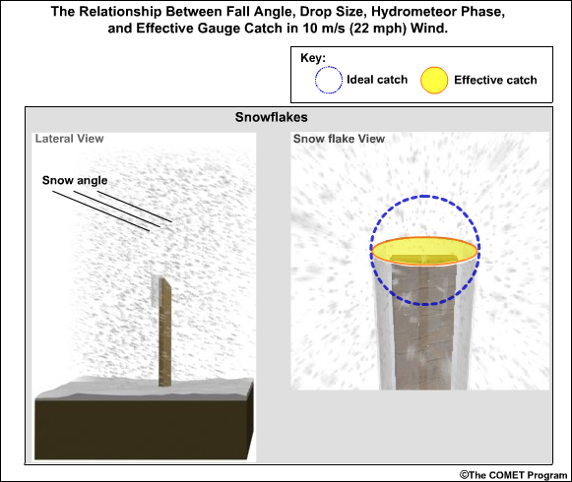
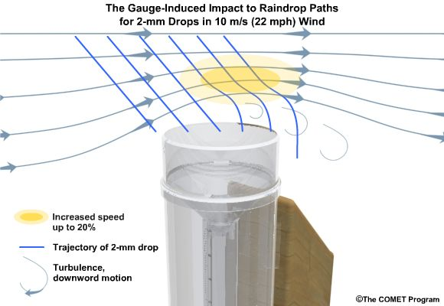
Rainfall and air temperature observation
Measurement Errors of Rainfall Observation – Manual Raingauge
Effect of wind
Measured Rainfall total is due to wind 2 – 15 % lower then real total.
In case of snowfall during strong wind there can be up to 80 % loss.

Slide 23
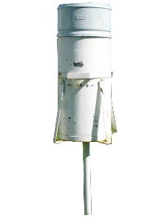
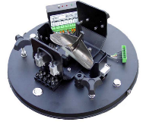
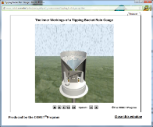
Rainfall and air temperature observation
Measurement Errors of Rainfall Observation – Automated Raingauge
Tipping bucket rain gauges underestimate real rainfall total.
The errors are usually between 5 to 10 % but can be bigger during heavy rain.
Automated raingauge
Manual raingauge
Comparison of the accumulated amount of precipitation from manual and automated tipping bucket at one location

Slide 24
Rainfall and air temperature observation
ČHMÚ operates ~ 1200 rain gauge stations
?
Why do we have more stations that measure precipitation than stations that measure air temperature?
ČHMÚ operates ~ 300 meteorological stations with measurement of air temperature

Slide 25
Weather observation
The most accurate spatial precipitation estimates are from combination (stations + radar)
radar
stations
merge

Slide 26
PART II. Application of long-term hydrological data
Hydrological regime
Evaluation of low flow characteristics
Evaluation of high (flood) characteristics
Flood mechanism description

Slide 27
Evaluation of low flow characteristics
The legal permit for all use of water from river is required.
Protection of the plants and animals living in the river.
Setting minimum flow that must remain in river.
Outflow
Water power plant
Dry river bed
Inflow
Weir

Slide 28
Evaluation of low flow characteristics
Method: Construction of Daily Mean Flow Frequency Curve
Required: Daily mean flow from period of 30 years

Slide 29
Evaluation of low flow characteristics
Why do we use only 30y record instead of the longer period that is available?
30-year period is long enough to get reliable mean and low flow values
.
.

Slide 30
Evaluation of low flow characteristics
It is easier to identify and describe flows that happen often then extremes.

Slide 31
Evaluation of low flow characteristics
How many years of discharge observation you need to get reliable estimate of the mean discharge?
The probability that the average flow will differ from the long-term average by less than 10%.
Length of observation

Slide 32
Evaluation of low flow characteristics
Why do we use only 30y record instead of the longer period that is available?
30 years period is long enough to get reliable mean and low flow values
Less problem with homogeneity of data.
.
Prague
reservoirs
A simple solution to the effect of dams built in 1950s and 1960s on minimum flows .
Flow frequency curve for the Vltava river in Prague calculated from two periods.

Slide 33
Evaluation of low flow characteristics
Why do we use only 30y record instead of the longer period that is available?
30 years period is long enough to get reliable mean and low flow
Less problem with homogeneity of data.
The restrictions that are related to low flow characteristics can be quite easy adjusted to better fit to current hydrological conditions.

Slide 34
Evaluation of flood characteristics
Every technical structure near the river or in the river must resist the flooding of certain level (severity).
Different level of protection for different structures.
Regulated by law.

Slide 35
Evaluation of flood characteristics
Method: Construction of Year Peak Flow Frequency Curve
Annual Exceedance Probability / Average Return Interval
Required: Annual maximum discharge from data series as long as available
Annual maximum of the Vltava river flow in Prague

Slide 36
Some statistics - Dice throwing
How many times do you have to throw two dice to get reliable estimates of:
1) average sum
2) frequency of extremes
50x
1000x

Slide 37
Evaluation of flood characteristics
Flood frequency analysis
Why the length of data series is so important?
1) Flood protection requires the design of floods with a very low probability of occurrence.
2) The values ​​should be stable, because the life expectancy of technical construction is long.

Slide 38
Evaluation of flood characteristics
Flood frequency analysis
Designed theoretical flood peaks before and after Flood 2002
Designed N – years flood for the Lomnice basin before and after flood in 2002
The highest levels of the Orlík dam exceeded in 2002 the permitted level by 1.5 meter!

Slide 39
Historical hydrology - basic terms
0
1000 a.d.
1500 a.d.
1900 a.d.
2000 a.d.
Timeline
Pre-instrumental period
Instrumental period
Proxy-data
Palaeohydrology
Palaeofloods
Historical hydrology
Historical floods
Hydrology
Floods

Slide 40
Historical hydrology – data and methods
Information from pre-instrumental period
Required:
Water levels and dates when the floods occurred.
Transformation to discharge.
Complete list of all floods above certain level (recommended).

Slide 41
Historical hydrology - basic terms
Flood frequency analysis – information from pre-instrumental period

Slide 42
Hydrological regime
Flood frequency analysis – information from pre-instrumental period
Palaeofloods
Historical
floods
PROBLEM:
Combination of different kind of data (observation /proxy)
(continuous / discrete) (accurate + estimates)
does not allow the use of standard statistical methods for flood frequency calculation.
Calenda, G., Mancini,C.P., Volpi, E. (2005): Distribution of the extreme peak floods of the Tiber River from the XV century, Advances in water resources, 2005 s. 615-624

Slide 43
Palaeohydrology
Definition: Study of water on Earth during previous periods of its history.
Palaeoflood: Indirect evidence of flooding (proxy data), usually fluvial sediments at specific location.
Required:
Location with deposition of flood sediments but protected from all kinds of erosion. For example caves or abandoned river bed.
Dating method such as radiocarbon, etc.

Slide 44
Palaeohydrology
Lang M. Historical floods in the Soutj-East of France
SPHERE and INONDHIS Project
http://www.eng.ox.ac.uk/samp/slides/OxJan08-LangMichel.pdf

Slide 45
Flood mechanism studies
Comprehensive study of causes and development of flood in a specific basin.
Required:
Rainfall totals, air temperature, snow observation, river flow form more water gauging
What we want to find out:
The most common causes of flood.
Seasonal aspect.
The area with the highest runoff.
Time development of outflow from different part of basin.
…..

Slide 46
Flood mechanism of the Otava river

Slide 47
Flood mechanism of the Otava river
Weather circulation conditions
Winter type – west circulation with strong wind
Summer type – low pressure in central Europe, east and north circulation
The Otava river basin
Center of low pressure formation before a during floods in Otava river. Winter / Summer type

Slide 48
Flood mechanism of the Otava river
Rainfall distribution
Winter type – strong orographic effect on the main mountain ridge
Summer type – slight orographic effect on north foothill more equal distribution
The area where with heavy rain before floods in Otava river. Winter / Summer type

Slide 49
Flood mechanism of the Otava river
Shape of flood hydrograph
Each type of flood conditions results in different flow development and different shape of flow hydrograph
Typical flood wave shape of the Otava river in Písek – Winter / rain / strong orography type

Slide 50
Flood mechanism of the Lužnice river
How the study of the causes of floods can be valuable for flood protection
„How could the flood came so quickly when the water was rising so slowly in 2002 ?„
Flood protection measures designed according to conditions of flood 2002 didn‘t work during flood in 2013

Slide 51
Flood mechanism of the Lužnice river
How the study of the causes of floods can be valuable for flood protection
There are two different types of summer floods in the lower Lužnice.
suitable for portable flood barriers
unsuitable for portable flood barriers

Slide 52
THE END

Slide 54
Important terms:
Annual Exceedance Probability (AEP) – Pravděpodobnost překročení (1% u stoleté povodně)
Average Return Interval (ARI) – Doba opakování povodně (100 letá povodeň)
Both are intversely related

